Slide 1
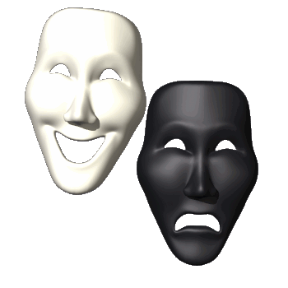
Personality
A person’s pattern of thinking, feeling and acting.

Slide 2
Table of Content
Definition of Personality
Factors influencing personality (Heredity & Environment)
Theories of Personality
Trait theory of Gordon Allport (not incl in 2CH course)
Hans Eysenck
Five Factor Model (Big-five theory)
Psychoanalytic Personality theory
Development of personality
Brief introduction to Neo Freudians (Alfred Adler, Carl Jung)

Slide 3
Table of Content
5. Behavioral Personality Theory
6. Social Cognitive Learning theory
7. Humanistic personality theory
Personality assessment
I. Projective tests (RIT, TAT, HTP, WAT)
II. Non-projective tests (MMPI, CPI)

Slide 4
Definitions
Personality refers to characteristic patterns of thinking, feeling, and behaving (Cacioppo & Freberg, 2013).
2. An individual’s unique and relatively stable
patterns of behavior, thoughts, and feelings
(Baron & Misra, 2014).
3. Personality refers to an individual’s unique
collection of consistent behavioral traits
(Weiten, 2011).

Slide 5


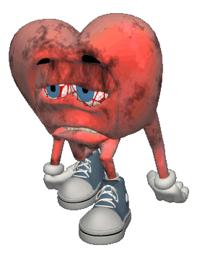
Types of Personalities
Type A
Type B
Ambitious
Easily angered
Stress Junkies
Highly competitive
Workaholics
Feel time pressure.
More prone to heart disease & hypertension
Relaxed
Calm and composed
Less stressed
Easygoing
Don’t face much health problems

Slide 6
Types of Personalities
Type A
Type B
Work hard
Play hard to win
Impatient
(get destructive)
Dominating
As hardworking as type A but they don’t mind losing
Play for entertainment
Flexible (get productive)
Emotional & Expressive
But some people fit in neither type

Slide 7
Factors influencing personality
Biological (Heredity)
Social (Environment)

Slide 8
Psychodynamic Perspectives
1-Freud’s Psychoanalytic Theory (Role of unconscious)
Freud’s Structure of Personality & Levels of Awareness
Defense mechanisms (Repression, Denial, Rationalization, Displacement, Projection, Regression)
Psychosexual Stages
2-Jung’s Analytical Psychology
3-Adler’s Individual Psychology

Slide 9
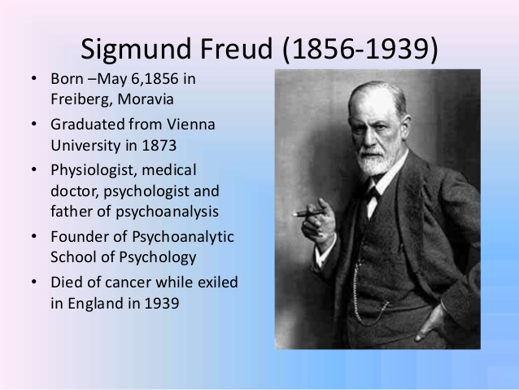
Psychoanalytic Theory of Personality
Fathered by Sigmund Freud.
Idea of the Libido (survival & sexual energy): driving force of all the behavior.
Proposed the concept of Instincts:
Eros (life instinct)
Thanatos (death
instinct)
What’s on our minds!!!
Sigmund Freud

Slide 10
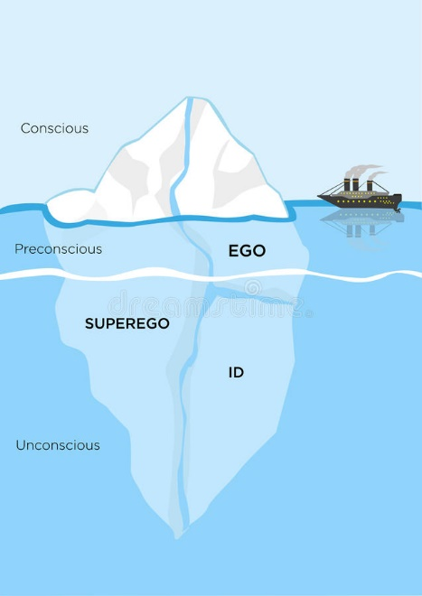
Freud’s Contribution in Psychology
Instincts
Eros– Life Instinct
Thanatos– Death Instinct
Structure of Personality
Id- ruled by pleasure principle
Ego: reality principle
Super Ego: morality principle
Structure of Mind/ Levels of awareness
Conscious level
Sub-Conscious level
Unconscious level
Defense Mechanisms
Psychosexual stages of development

Slide 11
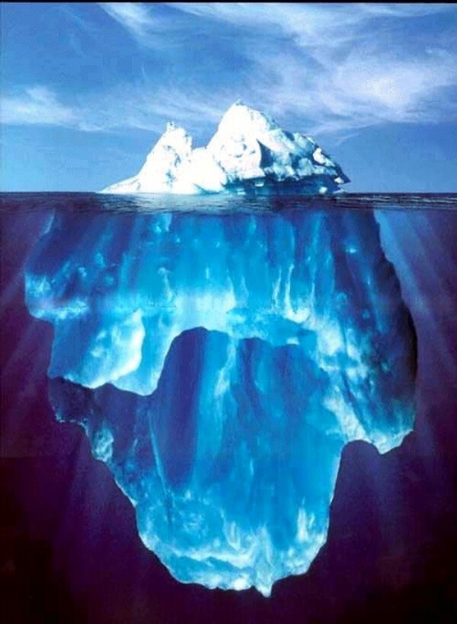
Structure of Mind/ levels of Awareness
Conscious- things we are aware of.
Preconscious- things we can be aware of if we think of them.
Unconscious- deep hidden reservoir that holds the true “us”. All of our desires and fears.

Slide 12
Freud’s Concept of Personality (Psyche)
Ego
Superego
Id

Slide 13
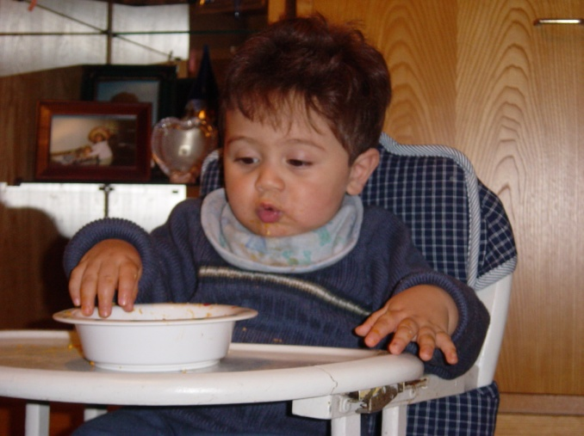
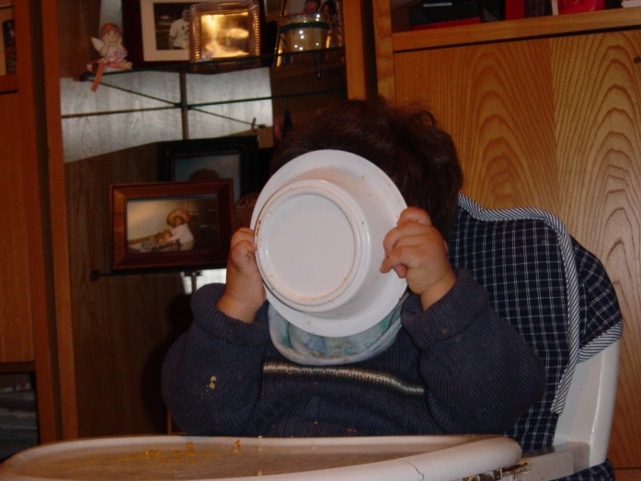
Id
Exists entirely in the unconscious (so we are never aware of it).
Our hidden true animalistic wants and desires.
Works on the Pleasure Principle
Avoids Pain and receives Instant Gratification.

Slide 14
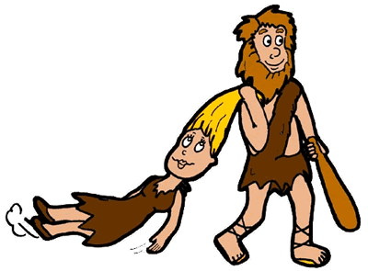
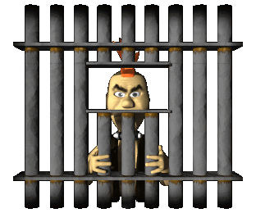
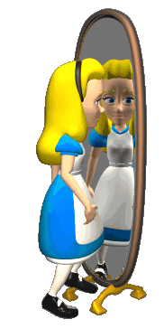
Ego
Example: If an individual seriously wants to harm his foe in order to take revenge. His id says just take the revenge, but his ego does not want to end up in jail or any serious consequences. So the person decides to stay out.
Develops after the Id
Works on the Reality Principle
Negotiates between the Id and the environment.
In our conscious and unconscious minds.
It is what everyone sees as our personality.

Slide 15
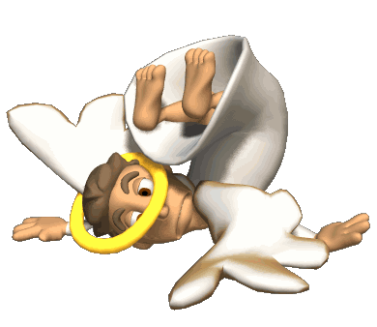
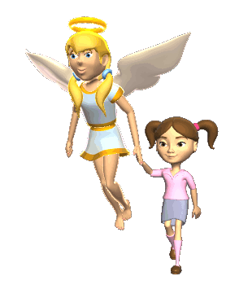
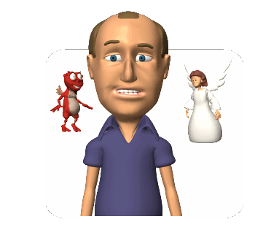
Superego
Develops last at about the age of 5
It is our conscience (what we think the difference is between right and wrong)
The Ego often mediates between the superego and id.

Slide 16
Freud’s Psychosexual stages of Development
Stages of Psycho-Sexual Development
are:
Oral
Anal
Phallic
Latent
Genital

Slide 17
Freud’s Psychosexual stages of Development
Stage
Oral stage
(birth to 1)
Main Characteristics
Pleasure obtained by sucking. At this stage in life infant’s gratification is oral, or mouth orientated, such as sucking, biting, and breastfeeding.
Freud said oral stimulation could lead to an oral fixation in later life, such as smoking, nail-biting, finger-chewing, and thumb sucking. Oral personalities engage in such oral behaviors, particularly when under stress.

Slide 18
Freud’s Psychosexual stages of Development
Anal stage
(1-3 years)
Conflict between child’s ability to eliminate wastes at will versus societal expectations of toilet training

Slide 19
Freud’s Psychosexual stages of Development Cont..
Oedipus and Electra complexes lead to identification with same-sex parents. Essentially, a boy feels that he is competing with his father for possession of his mother (OC), while a girl feels that she is competing with her mother for her father's affections (EC).
Phallic stage
(3-6 years)

Slide 20
Freud’s Psychosexual stages of Development Cont...
Latency stage
(6-12 years)
Focus on internalization of society’s rules. Freud thought that most sexual impulses are repressed during the latent stage, and sexual energy can be sublimated (defense mechanism) towards school, work, hobbies, and friendships.
Much of the child's energy is channeled into developing new skills and acquiring new knowledge, and play becomes largely confined to other children of the same gender.

Slide 21
Freud’s Psychosexual stages of Development Cont…
Genital stage
(12 years and
above)
This is the last stage of Freud's psychosexual theory of personality development and begins in puberty.
The focus of this stage is on adult sexual interests and behaviors.

Slide 22
Fixation (defined)
an obsessive preoccupation with a single idea, impulse, or aim.
in psychoanalytic theory, the persistence of an early stage of psychosexual development or the inappropriate attachment to an early psychosexual object or mode of gratification, such as anal or oral activity; this fixation limits the person’s ability to negotiate the tasks of later psychosexual stages (APA, 2023).

Slide 23
Following fixations can occur if the major conflicts in each stage are not adequately resolved:
Oral fixation: adulthood may be characterized by excessive eating, smoking, drinking, talking
Anal fixation: adult may be anal-retentive (excessively clean, meticulous, obsessive) or anal-expulsive (moody, sarcastic, untidy in personal habits)
Phallic fixation: vain, arrogant, self-absorbed

Slide 24
Slide not included in Mid-2
https://www.verywellmind.com/what-is-a-fixation-2795188

Slide 25
Slide not included in Mid-2
Carl Jung was an introverted, excellent student, and an established young psychiatrist in Zurich
Jung and Freud exchanged 359 letters before their friendship and theoretical alliance were torn apart in 1913
Jung called his new approach Analytical Psychology to differentiate it from Freud’s Psychoanalytic Theory

Slide 26
2. Jung’s Analytical Psychology
(like Freud, Jung emphasized the unconscious determinants of personality. He proposed that unconscious has two layers)
1. Personal Unconscious
2. Collective Unconscious
It’s the same as Freud’s version of unconscious
It’s not within one’s conscious awareness, because it has been repressed or forgotten.
A deeper layer of unconscious “CU a storehouse of latent memory traces inherited from people’s ancestral past”.
These ancestral memories called “Archetypes are emotionally charged images and thought forms that have universal meaning”.

Slide 27
3. Adler’s Individual Psychology
Like Jung, Adler argued that rather centering on sexual conflicts, the foremost source of human motivation is a striving for superiority
Adler saw Striving for Superiority as a prime goal of life and a universal drive to adapt, improve oneself, and master life challenges.
Example
Young children→ feeling helpless or weak in comparison to older children and adults. These early inferiority feelings motivate them to acquire new skills,and develop new talents.
“Compensation- involves efforts to overcome imagined or real inferiorities by developing one’s abilities
Inferiority Complex-exaggerated feelings of weakness and inadequacy.
Parental pampering or parental neglect could cause an inferiority complex
Birth Order influence our personality

Slide 28
Behavioral Perspectives
1-B.F. Skinner's Behavioral Approach to Personality
2-Bandura’s Social Cognitive Theory (from Weiten)
Behaviorism is a theoretical orientation based on the premise that scientific psychology should study only observable behavior.
1. Skinner’s Theory of Personality
Skinner made no provisions for internal personality structures similar to Freud ID, Ego, Superego. Instead, he focused on how the external environment molds overt behavior

Slide 29
Personality Development as a process of Conditioning
Skinner view personality development as a continuous, lifelong journey. His theory accounts for personality development by explaining how various response tendencies are acquired through learning
Example: S-- O– R formula
According to Skinner, people’s characteristic response tendencies are shaped by reinforcers and other consequences that follow behavior. Example: if you’re joking at a party pays off with favorable attention, your tendency to joke at parties will increase (reinforcement) and vice-versa (negative consequences-punishment weakens the behavior).

Slide 30
Personality Development through Operant Conditioning
Operant Conditioning: Learning in which a voluntary response is strengthened or weakened, depending on its favorable or unfavorable consequences (Feldman,2011).
B.F. Skinner focused on the role of Reinforcement.
Reinforcement: The process by which a stimulus increases the probability that a preceding behavior will be repeated (Feldman, 2011).

Slide 31
Personality Development through Operant Conditioning
Reward/ Reinforcer: A stimulus that increases the frequency of a behavior.
  can be used interchangeably with the term positive reinforcement.
Punishment: A stimulus that decreases the probability that a previous behavior will occur again.
Example: To clean the house to get rid of the physical abuse by parents.

Slide 32
Humanistic Personality Theory
1-Carl Rogers' Person-Centered Theory
Self-Concept
Development of the Self and Anxiety and Defense
2-Maslow's Theory of Self-Actualization and hierarchy of needs (from chapter 1 or Motivation)
Humanism is theoretical orientation that emphasizes the unique qualities of humans, especially their freedom and their potential for personal growth
1. In Roger’s model of personality, the self concept is the only important structural construct. Congruence- self-concept meshes well with reality (actual experience), Incongruence- self-concept does not mesh well with reality.

Slide 33
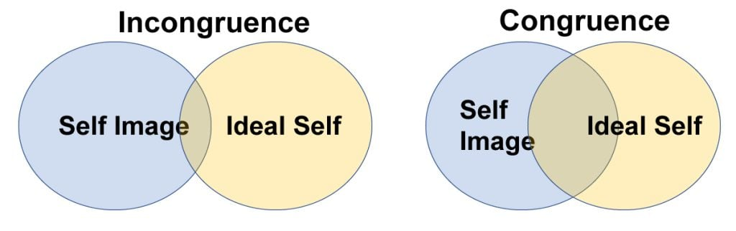
The Self/ Self-Concept
“it is a collection of beliefs about one’s nature, unique qualities, and typical behavior”

Slide 34
Development of the Self and personality
According to Carl Rogers, Unconditional Love from parents tends to foster an accurate self-concept that is congruent with reality.
Conditional Love from parents fosters incongruence.
Experiences that threaten people’s personal views of themselves are the principal cause of troublesome anxiety.

